Slide 1


RCG|enable™ Banking
Welcome, Mike Sommers
Use Case
Party Resolution
Event Management
PATTERN ANALYSIS
SOLUTION ROI
Technology
Today’s situation with Anti-Money Laundering…
Operational
Systems
Core Data
Transaction
Monitoring
Alerts
Case
Management
Banks are challenged with improving compliance and reducing cost
10X
10%
$75K
Increase in penalties during
2000-2015
FSOs that faced enforced remediation
in 2016
Median salary for US-based AML investigator

Slide 2








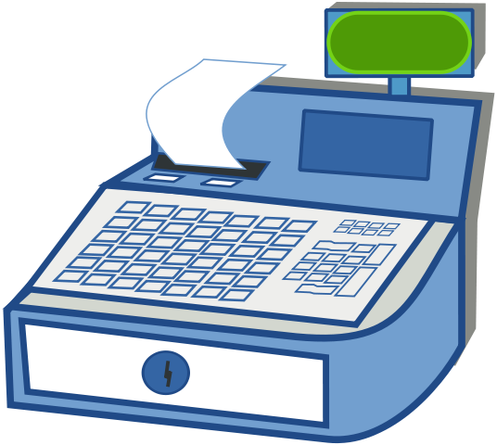


RCG|enable™ Banking
Welcome, Mike Sommers
Use Case
Party Resolution
Event Management
PATTERN ANALYSIS
SOLUTION ROI
Technology
Personal
Business
ALERTS
Operational
Systems
Core Data
Transaction
Monitoring
Alerts
Case
Management
PARTY
TRANSACTION
MONITORING
SYSTEM (TMS)
CASE
MANAGEMENT
TOOL (CMT)
Corporate & Institutional
ACCOUNT
Investment
Credit
TRANSACTION
12,000 ACCOUNTS
10,000 PARTIES
1,000,000 TRANSACTIONS
100,000 ALERTS
100,000 CASES, 10 SARs
900,000 NON-ALERTS
Are all of these truly in compliance?
Do all these alerts need investigating?
Are all case investigations
needed?

Slide 3
RCG|enable™ Banking
Welcome, Mike Sommers
Use Case
Party Resolution
Event Management
PATTERN ANALYSIS
SOLUTION ROI
Technology
Personal
Business
ALERTS
Operational
Systems
Core Data
Transaction
Monitoring
Alerts
Case
Management
PARTY
TRANSACTION
MONITORING
SYSTEM (TMS)
CASE
MANAGEMENT
TOOL (CMT)
Corporate & Institutional
ACCOUNT
Investment
Credit
TRANSACTION
12,000 ACCOUNTS
10,000 PARTIES
1,000,000 TRANSACTIONS
100,000 ALERTS
100,000 CASES, 10 SARs
6,000 40%⬇
900,000 NON-ALERTS
PARTY NAME | ALIASES | # ACCOUNTS | RISK LEVEL
Allan B Summers | Al Summers | 3 | Low
Benjamin Summers | Ben Summers | 2 | Medium
Max J Eisenhardt | Jakob Eisenhardt | 3 | High
Erik Lehnsherr | - | 2 | Low
Michael J Xavier | John Xavier | 2 | Low
Michael White | - | 2 | Medium
Warren Worthington III | - | 3 | Low
James Worthington III | - | 3 | Low
Cain Marko | Charles Marko | 4 | Low
Cain Xavier | - | 2 | Low
John Newton | - | 1 | Low
PARTY NAME | ALIASES | # ACCOUNTS | RISK LEVEL
Allan B Summers | Al Summers Benjamin Summers Ben Summers | 5 | Medium
Max J Eisenhardt | Jakob Eisenhardt Erik Lehnsherr Michael J Xavier John Xavier Michael White | 9 | High
Warren Worthington III | -James Worthington III | 6 | Low
Cain Marko | Charles Marko Cain Xavier John Newton | 7 | Low
Incorrect Address
Non-standard Format
Missing Data
Multiple Names
Missing Country
Mis-fielded Data
Typographical Errors
Matching Records

Slide 4
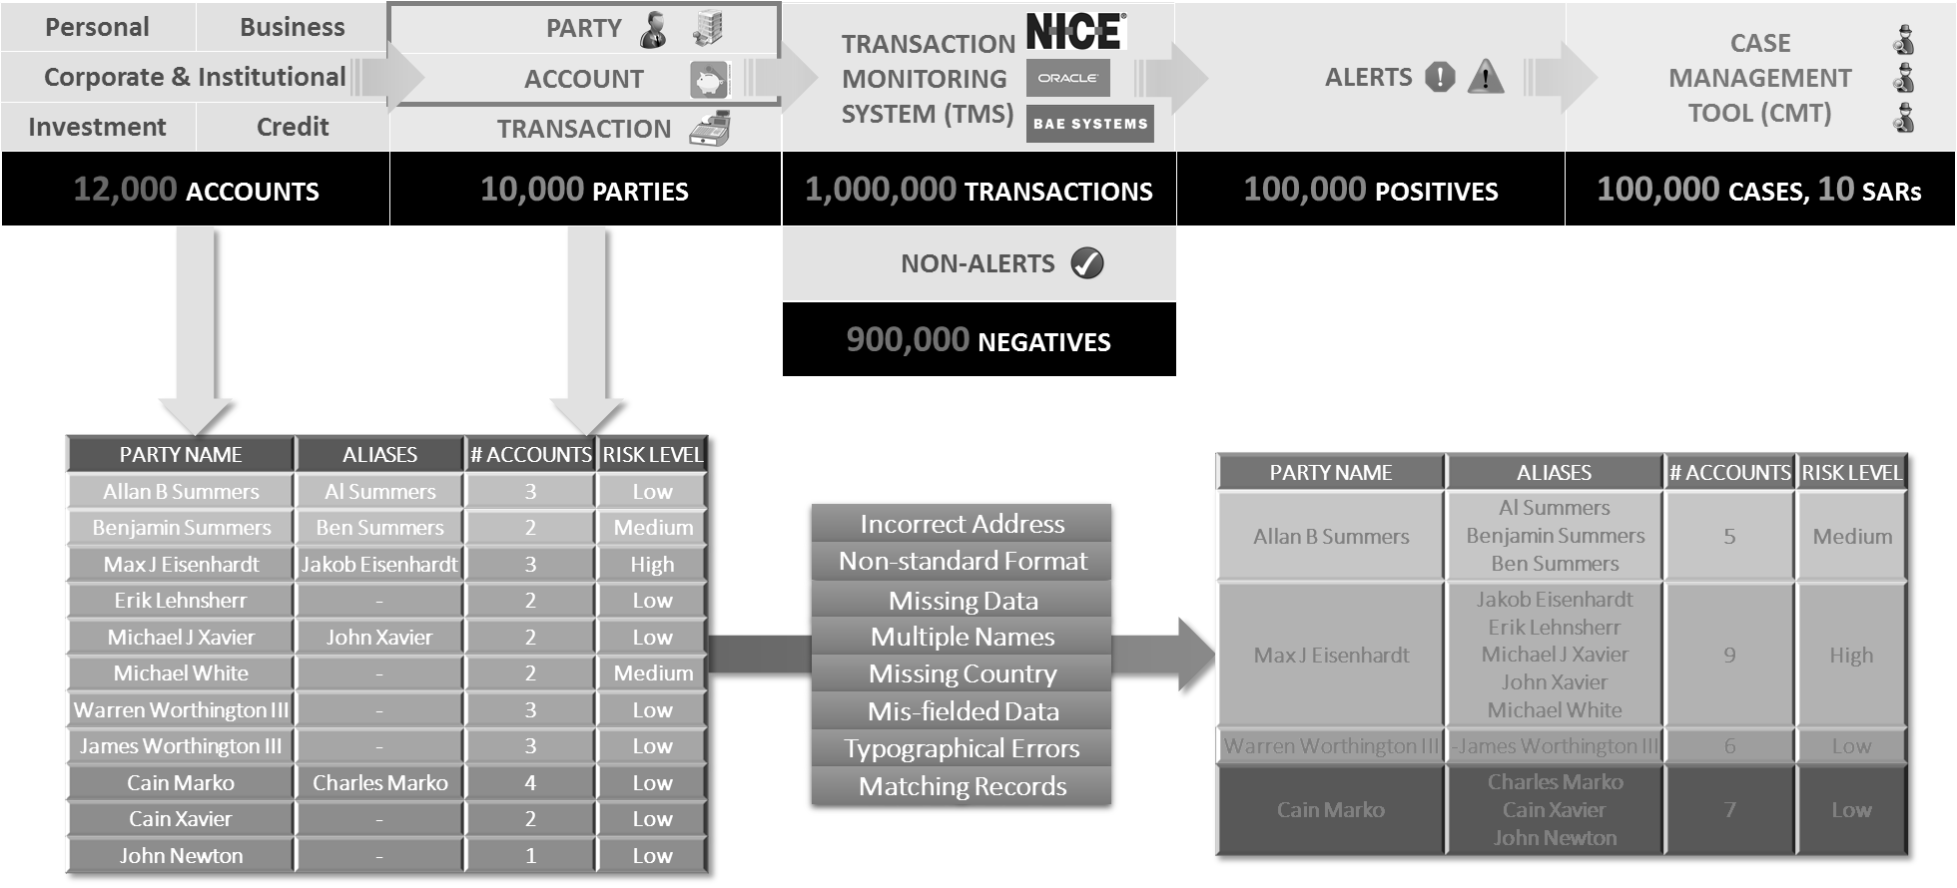
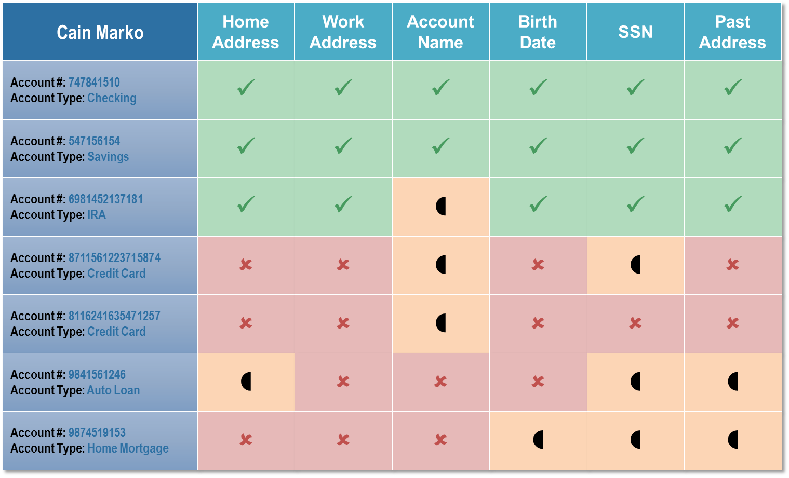
RCG|enable™ Banking
Welcome, Mike Sommers
Modal window when user clicks one of the accountholder names on the last screen
The greyed out material is just to indicate that the focus needs to be on the modal window; whatever design standards have been agreed upon need to be used
Use Case
Party Resolution
Event Management
PATTERN ANALYSIS
SOLUTION ROI
Technology

Slide 5
RCG|enable™ Banking
Welcome, Mike Sommers
Use Case
Party Resolution
Event Management
PATTERN ANALYSIS
SOLUTION ROI
Technology
Personal
Business
ALERTS
Operational
Systems
Core Data
Transaction
Monitoring
Alerts
Case
Management
PARTY
TRANSACTION
MONITORING
SYSTEM (TMS)
CASE
MANAGEMENT
TOOL (CMT)
Corporate & Institutional
ACCOUNT
Investment
Credit
TRANSACTION
12,000 ACCOUNTS
10,000 PARTIES
1,000,000 TRANSACTIONS
100,000 ALERTS
100,000 CASES, 10 SARs
6,000 40%⬇
900,000 NON-ALERTS
109,000 9%⬆
109,000 9%⬆
891,000 1%⬇
PARTY NAME | ALIASES | # ACCOUNTS | RISK LEVEL | # TRANS | # ALERTS
Allan B Summers | Al Summers | 3 | Medium | 52
Benjamin Summers | Ben Summers | 2 |  | 48 | 48
Max J Eisenhardt | Jakob Eisenhardt | 3 | High | 66 | 66
Erik Lehnsherr | - | 2 |  | 56
Michael J Xavier | John Xavier | 2 |  | 49
Michael White | - | 2 |  | 47 | 47
Warren Worthington III | - | 3 | Low | 71
James Worthington III | - | 3 | Low | 57
Cain Marko | Charles Marko | 4 | Low | 76
Cain Xavier | - | 2 | Low | 58
John Newton | - | 1 | Low | 18
PARTY NAME | ALIASES | # ACCOUNTS | RISK LEVEL | # TRANS | # ALERTS
Allan B Summers | Al Summers | 3 | Low | 52
Benjamin Summers | Ben Summers | 2 | Medium | 48 | 48
Max J Eisenhardt | Jakob Eisenhardt | 3 | High | 66 | 66
Erik Lehnsherr | - | 2 | Low | 56
Michael J Xavier | John Xavier | 2 | Low | 49
Michael White | - | 2 | Medium | 47 | 47
Warren Worthington III | - | 3 | Low | 71
James Worthington III | - | 3 | Low | 57
Cain Marko | Charles Marko | 4 | Low | 76
Cain Xavier | - | 2 | Low | 58
John Newton | - | 1 | Low | 18
PARTY NAME | ALIASES | # ACCOUNTS | RISK LEVEL
Allan B Summers | Al Summers | 3 | Low
Benjamin Summers | Ben Summers | 2 | Medium
Max J Eisenhardt | Jakob Eisenhardt | 3 | High
Erik Lehnsherr | - | 2 | Low
Michael J Xavier | John Xavier | 2 | Low
Michael White | - | 2 | Medium
Warren Worthington III | - | 3 | Low
James Worthington III | - | 3 | Low
Cain Marko | Charles Marko | 4 | Low
Cain Xavier | - | 2 | Low
John Newton | - | 1 | Low
PARTY NAME | ALIASES | # ACCOUNTS | RISK LEVEL | # TRANS | # ALERTS
Allan B Summers | Al Summers Benjamin Summers Ben Summers | 5 | Medium | 100 | 1
Max J Eisenhardt | Jakob Eisenhardt Erik Lehnsherr Michael J Xavier John Xavier Michael White | 9 | High | 218 | 1
Warren Worthington III | -James Worthington III | 6 | Low | 128
Cain Marko | Charles Marko Cain Xavier John Newton | 7 | Low | 152
PARTY NAME | ALIASES | # ACCOUNTS | RISK LEVEL
Allan B Summers | Al Summers Benjamin Summers Ben Summers | 5 | Medium
Max J Eisenhardt | Jakob Eisenhardt Erik Lehnsherr Michael J Xavier John Xavier Michael White | 9 | High
Warren Worthington III | -James Worthington III | 6 | Low
Cain Marko | Charles Marko Cain Xavier John Newton | 7 | Low

Slide 6
RCG|enable™ Banking
Welcome, Mike Sommers
Use Case
Party Resolution
Event Management
PATTERN ANALYSIS
SOLUTION ROI
Technology
Personal
Business
ALERTS
Operational
Systems
Core Data
Transaction
Monitoring
Alerts
Case
Management
PARTY
TRANSACTION
MONITORING
SYSTEM (TMS)
CASE
MANAGEMENT
TOOL (CMT)
Corporate & Institutional
ACCOUNT
Investment
Credit
TRANSACTION
12,000 ACCOUNTS
10,000 PARTIES
1,000,000 TRANSACTIONS
100,000 ALERTS
100,000 CASES, 10 SARs
6,000 40%⬇
900,000 NON-ALERTS
100,157 .16%⬆
109,000 9%⬆
76,300 24%⬇
109,000 9%⬆
76,300 24%⬇
891,000 1%⬇
899,843 .02%⬇
12 SARs 20%⬆
TRAN DATE | ORIG ACCT NAME | ORIG ACCT | ORIG ACCT TYPE | BENE ACCT NAME | BENE ACCT | BENE ACCT TYPE | BENE TYPE | AMOUNT | RISK SCORE | REAS CODE
12/22/2016 | John Miller | 8986742402353060 | Brokerage | John Miller | 8885874888002410 | Personal Checking | Individual | $ 13579.94 | 23 | EDUC
12/23/2016 | John Miller | 8885874888002410 | Personal Checking | Sara Miller | 4669911227420210 | Personal Checking | Individual | $ 13221.18 | 23 | EDUC
12/27/2016 | Sara Miller | 4669911227420210 | Personal Checking | Kayla Miller | 3845264412530440 | Personal Checking | Individual | $ 13221.18 | 23 | EDUC
12/29/2016 | Kayla Miller | 3845264412530440 | Personal Checking | Hofstra University | 9983250102142650 | Institutional | Educational | $ 13221.18 | 23 | EDUC
12/01/2016 | Jakob Eisenhardt | 7834387065827730 | Business Checking | Cain Marko | 3587245496400580 | Personal Checking | Individual | $ 2451.08
12/03/2016 | Erik Lehnsherr | 4539144912418400 | Personal Checking | Charles Marko | 7592319833746780 | Personal Checking | Individual | $ 2515.86
12/05/2016 | Michael J Xavier | 8236067807559860 | Business Checking | Cain Xavier | 4689820176460600 | Personal Checking | Individual | $ 2544.39
12/07/2016 | John Xavier | 5817615901604970 | Business Checking | John Newton | 2754883146226670 | Personal Checking | Individual | $ 2467.57
12/08/2016 | Michael White | 9624082862719340 | Personal Checking | Cain Marko | 6204565994791050 | Personal Checking | Individual | $ 2483.05
TRAN DATE | ORIG ACCT NAME | ORIG ACCT | ORIG ACCT TYPE | BENE ACCT NAME | BENE ACCT | BENE ACCT TYPE | BENE TYPE | AMOUNT | RISK SCORE | REAS CODE
12/22/2016 | John Miller | 8986742402353060 | Brokerage | John Miller | 8885874888002410 | Personal Checking | Individual | $ 13579.94 | 23 | EDUC
12/23/2016 | John Miller | 8885874888002410 | Personal Checking | Sara Miller | 4669911227420210 | Personal Checking | Individual | $ 13221.18 | 23 | EDUC
12/27/2016 | Sara Miller | 4669911227420210 | Personal Checking | Kayla Miller | 3845264412530440 | Personal Checking | Individual | $ 13221.18 | 23 | EDUC
12/29/2016 | Kayla Miller | 3845264412530440 | Personal Checking | Hofstra University | 9983250102142650 | Institutional | Educational | $ 13221.18 | 23 | EDUC
12/01/2016 | Jakob Eisenhardt | 7834387065827730 | Business Checking | Cain Marko | 3587245496400580 | Personal Checking | Individual | $ 2451.08 | 81 | WLST, >LMT
12/03/2016 | Erik Lehnsherr | 4539144912418400 | Personal Checking | Charles Marko | 7592319833746780 | Personal Checking | Individual | $ 2515.86 | 81 | WLST, >LMT
12/05/2016 | Michael J Xavier | 8236067807559860 | Business Checking | Cain Xavier | 4689820176460600 | Personal Checking | Individual | $ 2544.39 | 81 | WLST, >LMT
12/07/2016 | John Xavier | 5817615901604970 | Business Checking | John Newton | 2754883146226670 | Personal Checking | Individual | $ 2467.57 | 81 | WLST, >LMT
12/08/2016 | Michael White | 9624082862719340 | Personal Checking | Cain Marko | 6204565994791050 | Personal Checking | Individual | $ 2483.05 | 81 | WLST, >LMT
TRAN DATE | ORIG ACCT NAME | ORIG ACCT | ORIG ACCT TYPE | BENE ACCT NAME | BENE ACCT | BENE ACCT TYPE | BENE TYPE | AMOUNT
12/22/2016 | John Miller | 8986742402353060 | Brokerage | John Miller | 8885874888002410 | Personal Checking | Individual | $ 13579.94
12/23/2016 | John Miller | 8885874888002410 | Personal Checking | Sara Miller | 4669911227420210 | Personal Checking | Individual | $ 13221.18
12/27/2016 | Sara Miller | 4669911227420210 | Personal Checking | Kayla Miller | 3845264412530440 | Personal Checking | Individual | $ 13221.18
12/29/2016 | Kayla Miller | 3845264412530440 | Personal Checking | Hofstra University | 9983250102142650 | Institutional | Educational | $ 13221.18
12/01/2016 | Jakob Eisenhardt | 7834387065827730 | Business Checking | Cain Marko | 3587245496400580 | Personal Checking | Individual | $ 2451.08
12/03/2016 | Erik Lehnsherr | 4539144912418400 | Personal Checking | Charles Marko | 7592319833746780 | Personal Checking | Individual | $ 2515.86
12/05/2016 | Michael J Xavier | 8236067807559860 | Business Checking | Cain Xavier | 4689820176460600 | Personal Checking | Individual | $ 2544.39
12/07/2016 | John Xavier | 5817615901604970 | Business Checking | John Newton | 2754883146226670 | Personal Checking | Individual | $ 2467.57
12/08/2016 | Michael White | 9624082862719340 | Personal Checking | Cain Marko | 6204565994791050 | Personal Checking | Individual | $ 2483.05
TRAN DATE | ORIG ACCT NAME | ORIG ACCT | ORIG ACCT TYPE | BENE ACCT NAME | BENE ACCT | BENE ACCT TYPE | BENE TYPE | AMOUNT | RISK SCORE | REAS CODE
12/22/2016 | John Miller | 8986742402353060 | Brokerage | John Miller | 8885874888002410 | Personal Checking | Individual | $ 13579.94 | 23 | EDUC
12/23/2016 | John Miller | 8885874888002410 | Personal Checking | Sara Miller | 4669911227420210 | Personal Checking | Individual | $ 13221.18 | 23 | EDUC
12/27/2016 | Sara Miller | 4669911227420210 | Personal Checking | Kayla Miller | 3845264412530440 | Personal Checking | Individual | $ 13221.18 | 23 | EDUC
12/29/2016 | Kayla Miller | 3845264412530440 | Personal Checking | Hofstra University | 9983250102142650 | Institutional | Educational | $ 13221.18 | 23 | EDUC
12/01/2016 | Jakob Eisenhardt | 7834387065827730 | Business Checking | Cain Marko | 3587245496400580 | Personal Checking | Individual | $ 2451.08
12/03/2016 | Erik Lehnsherr | 4539144912418400 | Personal Checking | Charles Marko | 7592319833746780 | Personal Checking | Individual | $ 2515.86
12/05/2016 | Michael J Xavier | 8236067807559860 | Business Checking | Cain Xavier | 4689820176460600 | Personal Checking | Individual | $ 2544.39
12/07/2016 | John Xavier | 5817615901604970 | Business Checking | John Newton | 2754883146226670 | Personal Checking | Individual | $ 2467.57
12/08/2016 | Michael White | 9624082862719340 | Personal Checking | Cain Marko | 6204565994791050 | Personal Checking | Individual | $ 2483.05
TRAN DATE | ORIG ACCT NAME | ORIG ACCT | ORIG ACCT TYPE | BENE ACCT NAME | BENE ACCT | BENE ACCT TYPE | BENE TYPE | AMOUNT
12/22/2016 | John Miller | 8986742402353060 | Brokerage | John Miller | 8885874888002410 | Personal Checking | Individual | $ 13579.94
12/23/2016 | John Miller | 8885874888002410 | Personal Checking | Sara Miller | 4669911227420210 | Personal Checking | Individual | $ 13221.18
12/27/2016 | Sara Miller | 4669911227420210 | Personal Checking | Kayla Miller | 3845264412530440 | Personal Checking | Individual | $ 13221.18
12/29/2016 | Kayla Miller | 3845264412530440 | Personal Checking | Hofstra University | 9983250102142650 | Institutional | Educational | $ 13221.18
12/01/2016 | Jakob Eisenhardt | 7834387065827730 | Business Checking | Cain Marko | 3587245496400580 | Personal Checking | Individual | $ 2451.08
12/03/2016 | Erik Lehnsherr | 4539144912418400 | Personal Checking | Charles Marko | 7592319833746780 | Personal Checking | Individual | $ 2515.86
12/05/2016 | Michael J Xavier | 8236067807559860 | Business Checking | Cain Xavier | 4689820176460600 | Personal Checking | Individual | $ 2544.39
12/07/2016 | John Xavier | 5817615901604970 | Business Checking | John Newton | 2754883146226670 | Personal Checking | Individual | $ 2467.57
12/08/2016 | Michael White | 9624082862719340 | Personal Checking | Cain Marko | 6204565994791050 | Personal Checking | Individual | $ 2483.05
TRAN DATE | ORIG ACCT NAME | ORIG ACCT | ORIG ACCT TYPE | BENE ACCT NAME | BENE ACCT | BENE ACCT TYPE | BENE TYPE | AMOUNT
12/22/2016 | John Miller | 8986742402353060 | Brokerage | John Miller | 8885874888002410 | Personal Checking | Individual | $ 13579.94
12/23/2016 | John Miller | 8885874888002410 | Personal Checking | Sara Miller | 4669911227420210 | Personal Checking | Individual | $ 13221.18
12/27/2016 | Sara Miller | 4669911227420210 | Personal Checking | Kayla Miller | 3845264412530440 | Personal Checking | Individual | $ 13221.18
12/29/2016 | Kayla Miller | 3845264412530440 | Personal Checking | Hofstra University | 9983250102142650 | Institutional | Educational | $ 13221.18
12/01/2016 | Jakob Eisenhardt | 7834387065827730 | Business Checking | Cain Marko | 3587245496400580 | Personal Checking | Individual | $ 2451.08
12/03/2016 | Erik Lehnsherr | 4539144912418400 | Personal Checking | Charles Marko | 7592319833746780 | Personal Checking | Individual | $ 2515.86
12/05/2016 | Michael J Xavier | 8236067807559860 | Business Checking | Cain Xavier | 4689820176460600 | Personal Checking | Individual | $ 2544.39
12/07/2016 | John Xavier | 5817615901604970 | Business Checking | John Newton | 2754883146226670 | Personal Checking | Individual | $ 2467.57
12/08/2016 | Michael White | 9624082862719340 | Personal Checking | Cain Marko | 6204565994791050 | Personal Checking | Individual | $ 2483.05

Slide 7
RCG|enable™ Banking
Welcome, Mike Sommers
Use Case
Party Resolution
Event Management
PATTERN ANALYSIS
SOLUTION ROI
Technology
Personal
Business
ALERTS
Operational
Systems
Core Data
Transaction
Monitoring
Alerts
Case
Management
PARTY
TRANSACTION
MONITORING
SYSTEM (TMS)
CASE
MANAGEMENT
TOOL (CMT)
Corporate & Institutional
ACCOUNT
Investment
Credit
TRANSACTION

Slide 8
Backup Source Material
To be removed prior to sending final mockup to ODC

Slide 9
Cain Marko
Home Address
Work Address
Account Name
Birth
Date
SSN
Past
Address
Account #: 747841510
Account Type: Checking
✓
✓
✓
✓
✓
✓
Account #: 547156154
Account Type: Savings
✓
✓
✓
✓
✓
✓
Account #: 6981452137181
Account Type: IRA
✓
✓

✓
✓
✓
Account #: 8711561223715874
Account Type: Credit Card
✗
✗

✗

✗
Account #: 8116241635471257
Account Type: Credit Card
✗
✗

✗
✗
✗
Account #: 9841561246
Account Type: Auto Loan

✗
✗
✗


Account #: 9874519153
Account Type: Home Mortgage
✗
✗
✗




Slide 10
RCG|enable™ Banking
Welcome, Mike Sommers
Use Case
Party Resolution
Event Management
Feedback Loop
SOLUTION ROI
Technology

